Slide 1

Lecture 7: Introduction to Probability-II
Dr. A. Ramesh
Department of Management Studies

Slide 2
Problem
A company data reveal that 155 employees worked one of four types of positions.
Shown here again is the raw values matrix (also called a contingency table) with the frequency counts for each category and for subtotals and totals containing a breakdown of these employees by type of position and by sex.

Slide 3
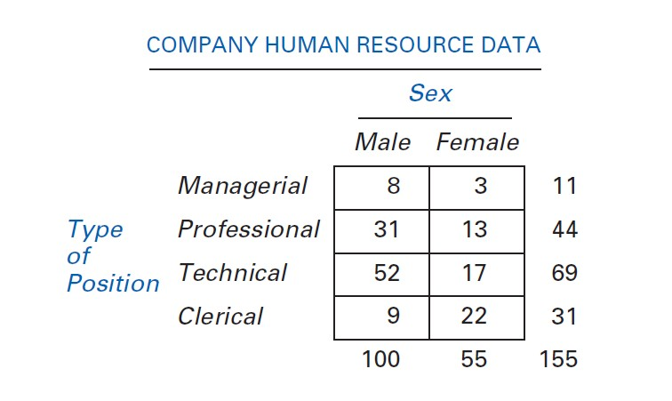
Contingency Table

Slide 4


Solution
If an employee of the company is selected randomly, what is the probability that the employee is female or a professional worker?

Slide 5
Problem
Shown here are the raw values matrix and corresponding probability matrix for the results of a national survey of 200 executives who were asked to identify the geographic locale of their company and their company’s industry type.
The executives were only allowed to select one locale and one industry type.

Slide 6
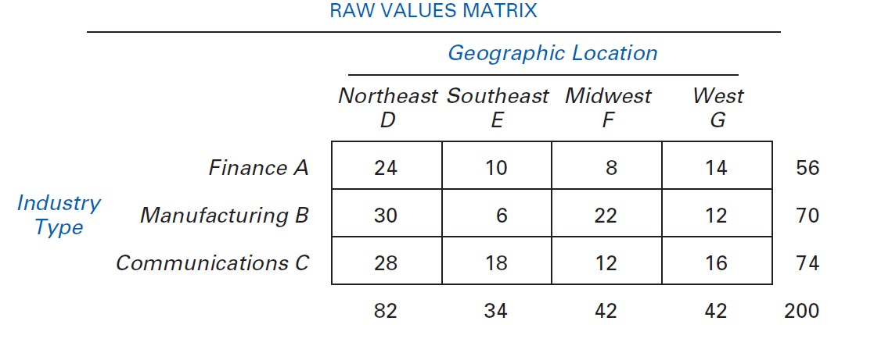

Slide 7
Questions
What is the probability that the respondent is from the Midwest (F)?
What is the probability that the respondent is from the communications industry (C) or from the Northeast (D)?
What is the probability that the respondent is from the Southeast (E) or
from the finance industry (A)?

Slide 8
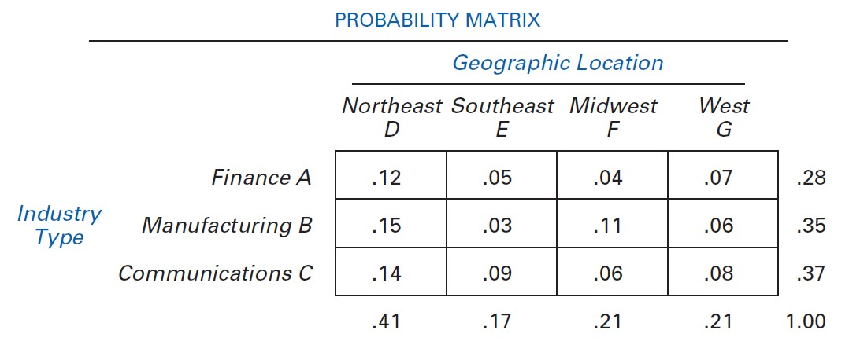

Slide 9
Mutually Exclusive Events
Type of Position | Gender Male Female | Total
Managerial |  | 11
Professional |  | 44
Technical |  | 69
Clerical |  | 31
Total | 100 55 | 155
8 | 3
31 | 13
52 | 17
9 | 22
P(T ∪ C) = P(T ) + P(C)
₌ 69 ₊ 31
155 155
=.645

Slide 10
Mutually Exclusive Events
Type of Position | Gender Male Female |  | Total
Managerial |  |  | 11
Professional |  |  | 44
Technical |  |  | 69
Clerical |  |  | 31
Total | 100 55 |  | 155
P( P ∪ C) = P( P) + P(C) ₌ 44 ₊ 31 =.484
8 | 3
31 | 13
52 | 17
9 | 22
155 155

Slide 11

Law of Multiplication
P( X ∩ Y ) = P( X) ⋅ P(Y| X) = P(Y ) ⋅ P( X|Y )

Slide 12
Problem
A company has 140 employees, of which 30 are supervisors.
Eighty of the employees are married, and 20% of the married employees are supervisors.
If a company employee is randomly selected, what is the probability that the employee is married and is a supervisor?

Slide 13
 |  | Married
 |  | Y | N | Sub total
Supervisor | Y | 0.1143 |  | 30
 | N |  |  | 110
 | Sub total | 80 | 60 | 140

Slide 14
P(M) = ⁸⁰ = 0. 5714
140
P(S| M) = 0. 20
P(M ∩ S) = P( M) ⋅ P(S| M)
= (0. 5714)(0. 20) = 0.1143

Slide 15
Law of Multiplication
Probability Matrix of Employees
Married
P(S ) = 1 − P(S)
= 1 − 0. 2143 = 0. 7857
P( M ∩ S ) = P(S ) − P( M ∩ S )
= 0. 7857 − 0. 4571 = 0.3286
Supervisor Yes No Yes .1143 .1000
No .4571 .3286
Total .5714 .4286
Total
.2143
.7857
1.00
P( M ∩ S ) = P( M) − P( M ∩ S)
= 0. 5714 − 0.1143 = 0. 4571
P( M ∩ S) = P(S) − P( M ∩ S)
= 0. 2143 − 0.1143 = 0.1000
P( M ) = 1 − P( M)
= 1 − 0. 5714 = 0. 4286

Slide 16
Special Law of Multiplication for Independent Events
General Law
P( X ∩Y ) = P( X ) ⋅ P(Y | X ) = P(Y ) ⋅ P( X | Y )
Special Law
If events X and Y are independent,
P( X ) = P( X | Y ), and P(Y ) = P(Y | X ).
Consequently,
P( X ∩Y ) = P( X ) ⋅ P(Y )

Slide 17
Law of Conditional Probability
The conditional probability of X given Y is the joint probability of X and Y divided by the marginal probability of Y.
_{P( X|Y ) =} P( X ∩ Y ) ₌ P(Y| X) ⋅ P( X)
P(Y ) P(Y )

Slide 18
Conditional Probability
A conditional probability is the probability of one event, given that another event has occurred:
The conditional probability of A given that B has occurred
_{P(A | B) =} P(Aand B)
P(B)
_{P(B| A) =} P(Aand B)
P(A)
The conditional probability of B given
that A has occurred
Where P(A and B) = joint probability of A and B
P(A) = marginal probability of A P(B) = marginal probability of B

Slide 19
Computing Conditional Probability
Of the cars on a used car lot, 70% have air conditioning (AC) and 40% have a CD player (CD). 20% of the cars have both.
What is the probability that a car has a CD player, given that it
has AC ?
We want to find P(CD | AC).

Slide 20
Computing Conditional Probability
 | CD | No CD | Total
AC | 0.2 | 0.5 | 0.7
No AC | 0.2 | 0.1 | 0.3
Total | 0.4 | 0.6 | 1.0
P(CD | AC) = ^{P(CDand AC)} = ^{.2} = .2857
P(AC) .7
Given AC, we only consider the top row (70% of the cars). Of these, 20% have a CD player. 20% of 70% is about 28.57%.

Slide 21
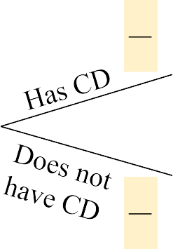


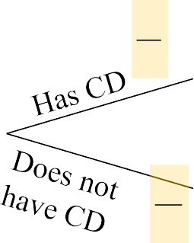
Computing Conditional Probability: Decision Trees
.2
.7
Given AC or no AC:
P(AC and CD) = .2
P(AC and CD/) = .5
.5
All Cars
.7
.2
.3
P(AC/ and CD) = .2
.1
.3
P(AC/ and CD/) = .1

Slide 22
Independent Events
If X and Y are independent events, the occurrence of Y does not affect the
probability of X occurring.
If X and Y are independent events, the occurrence of X does not affect the probability of Y occurring.
If X and Y are independent event,
P( X|Y ) = P( X), and
P(Y| X) = P(Y ).

Slide 23
Statistical Independence
Two events are independent if and only if:
P(A | B) = P(A)
Events A and B are independent when the probability of one event is not affected by the other event

Slide 24
Independent Events Demonstration
Geographic Location
 | Northeast D | Southeast E | Midwest F | West G
Finance A | .12 | .05 | .04 | .07 | .28
Manufacturing B | .15 | .03 | .11 | .06 | .35
Communications C | .14 | .09 | .06 | .08 | .37
 | .41 | .17 | .21 | .21 | 1.00
Test the matrix for the 200 executive responses to determine whether industry type is independent of geographic location.

Slide 25
Independent Events Demonstration
Contd…
P( A ∩ G) 0.07
P( A|G) =
= _{0.21} = 0.33
P( A) = 0.28
P(G)
P( A|G) = 0.33 ≠ P( A) = 0.28

Slide 26
Independent Events
 | D |  | E
A |  | 8 |  | 12 | 20
B |  | 20 |  | 30 | 50
C |  | 6 |  | 9 | 15
 |  | 34 |  | 51 | 85
P( A| D) = ⁸ =.2353
34
P( A) = ²⁰ =.2353
85
P( A| D) = P( A) = 0.2353

Slide 27
Revision of Probabilities: Bayes’ Rule
An extension to the conditional law of probabilities
Enables revision of original probabilities with new information
P(Y| Xi )P( Xi )
P(Y| X1)P( X1) + P(Y| X 2)P( X 2) + ⋅⋅⋅P(Y| Xn)P( Xn)
P( Xi|Y ) =

Slide 32
Problem
A particular type of printer ribbon is produced by only two companies, Alamo Ribbon Company and South Jersey Products.
Suppose Alamo produces 65% of the ribbons and that South Jersey produces 35%.
Eight percent of the ribbons produced by Alamo are defective and 12% of the South Jersey ribbons are defective
A customer purchases a new ribbon. What is the probability that Alamo produced the ribbon? What is the probability that South Jersey produced the ribbon?

Slide 33
Revision of Probabilities with Bayes' Rule: Ribbon Problem
P( Alamo) = 0.65
P(SouthJersey) = 0.35
P(d| Alamo) = 0. 08
P(d| SouthJersey) = 0.12
P(d| Alamo) ⋅ P( Alamo)
P(d| Alamo) ⋅ P( Alamo) + P(d| SouthJersey) ⋅ P(SouthJersey) (0. 08)(0.65)
P( Alamo| d) =
=
= 0. 553
(0. 08)(0.65) + (0.12)(0.35)
P(d| SouthJersey) ⋅ P(SouthJersey)
P(d| Alamo) ⋅ P( Alamo) + P(d| SouthJersey) ⋅ P(SouthJersey) (0.12)(0.35)
P(SouthJersey| d) =
=
= 0. 447
(0. 08)(0.65) + (0.12)(0.35)

Slide 34
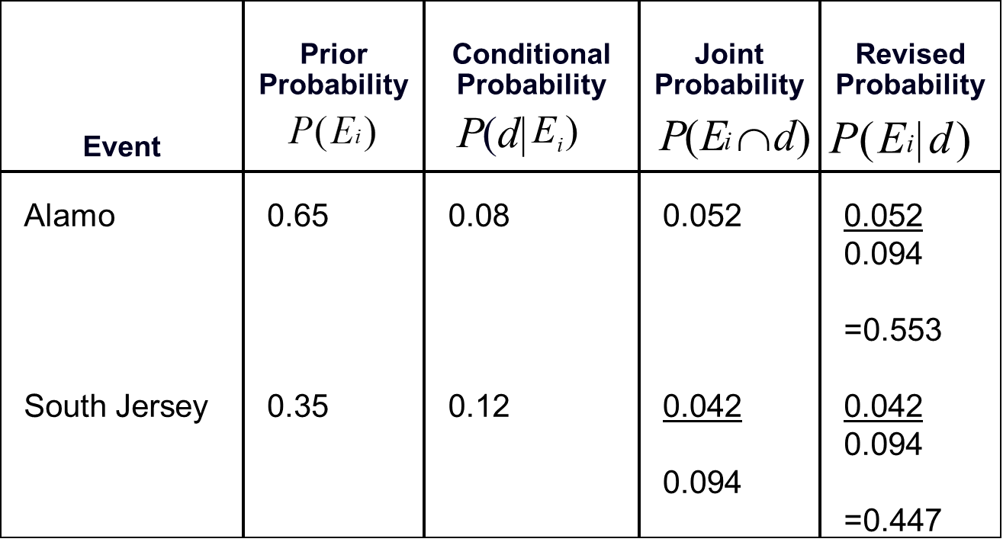
Revision of Probabilities with Bayes’ Rule: Ribbon Problem

Slide 35
Revision of Probabilities with Bayes' Rule: Ribbon Problem
Defective
0.08
0.052
Alamo 0.65
Acceptable
0.92
Defective 0.12
+
0.094
0.042
South Jersey 0.35
Acceptable
0.88

Slide 36
THANK YOU
36

